Slide 1
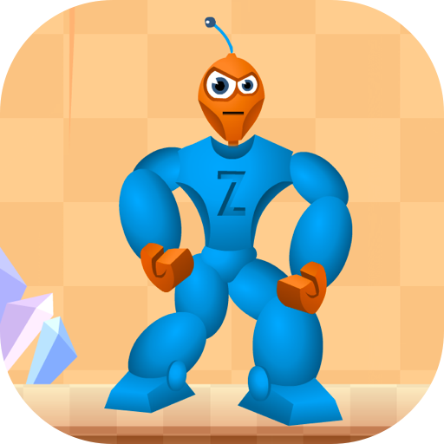
CSCI 599: Fireboy and Watergirl (Zed)
Aditi Swaroop Mitali Mehta nigrah bamb Yash shah naman Gupta

Slide 2
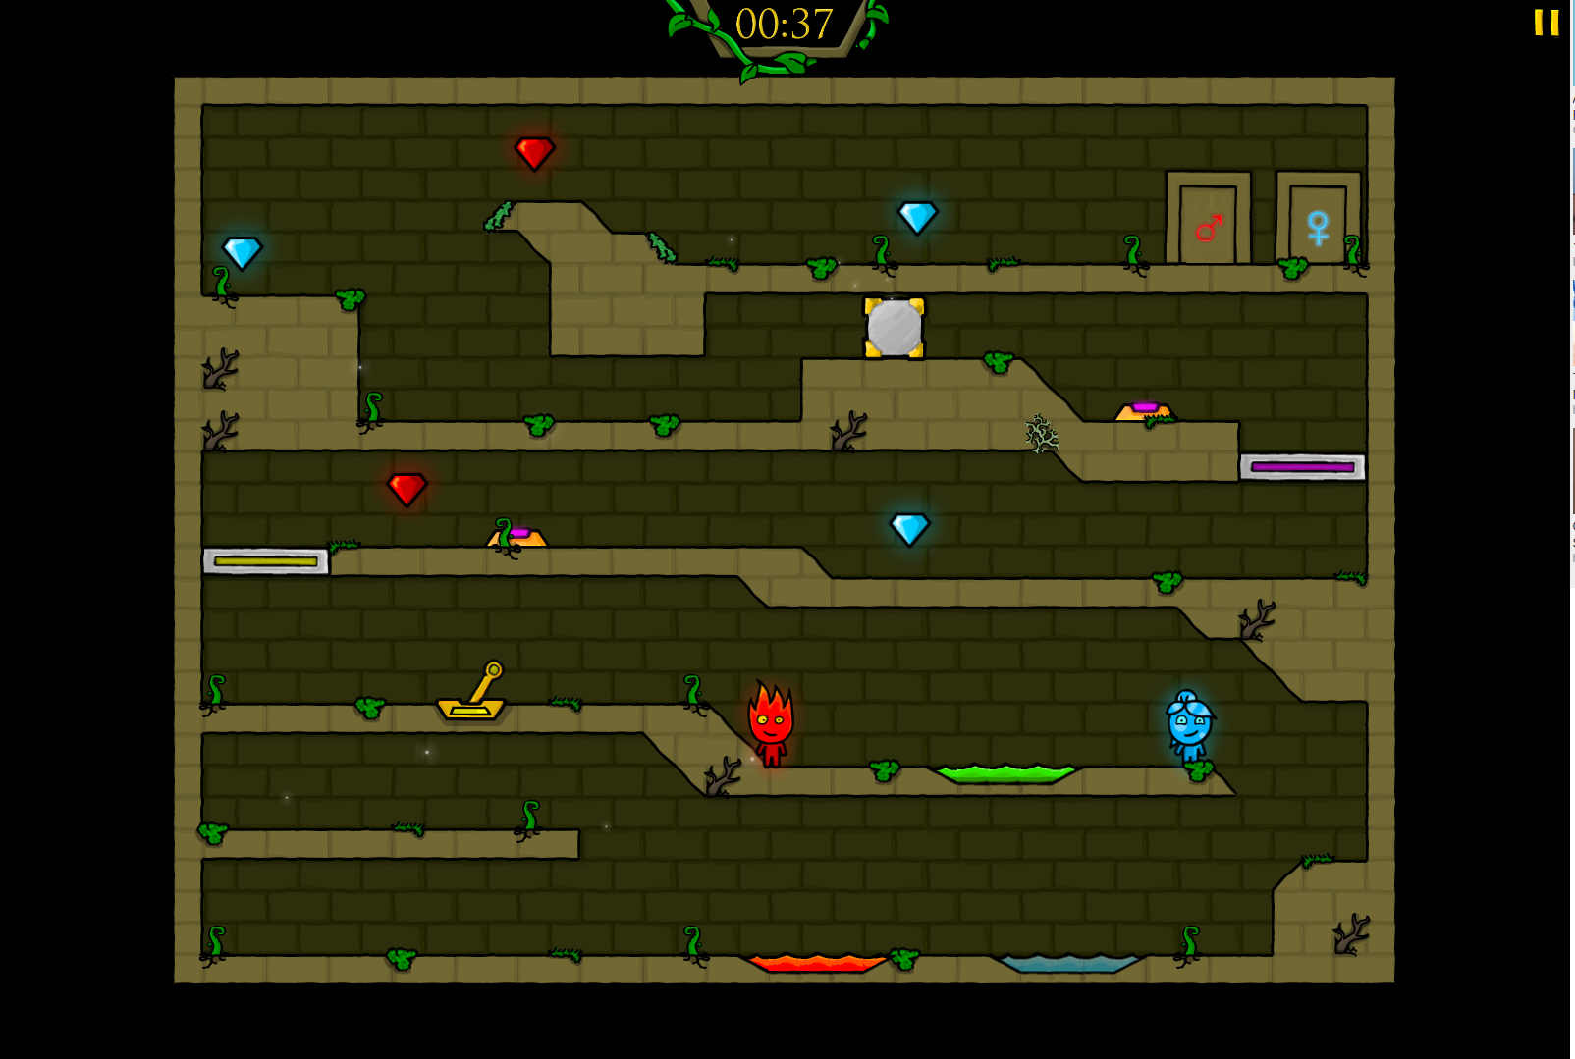
Why we changed our game.
Multi-agent reinforcement learning.
No useful information on the screen.
Would require immense amount of training.

Slide 3
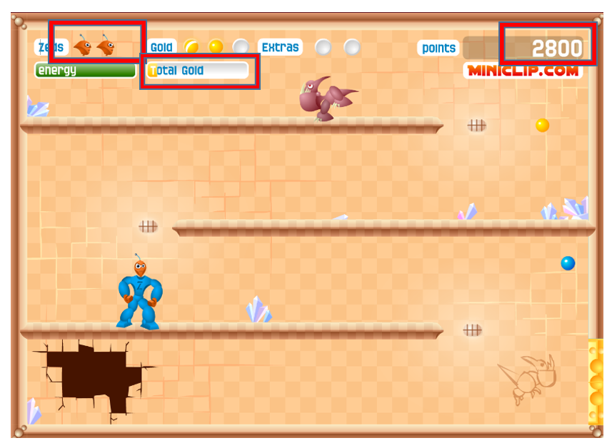
What ‘Zed’ provides us and how we use it.
Just like Fireboy and Watergirl but with a single agent.
Useful information on screen for assigning rewards.
Pytesseract for parsing and reading text.
cv2 for performing image manipulation

Slide 4
Our Progress
Researched about Q-Learning and Deep Q-Networks .
Read about reinforcement learning for games.
Implemented Deep Q-Learning for Cart-Pole Environment in OpenAi Gym (for practice).
Built a Q-Learning model for our agent.
Trained the model for 100 games, 100 game-steps each.

Slide 5
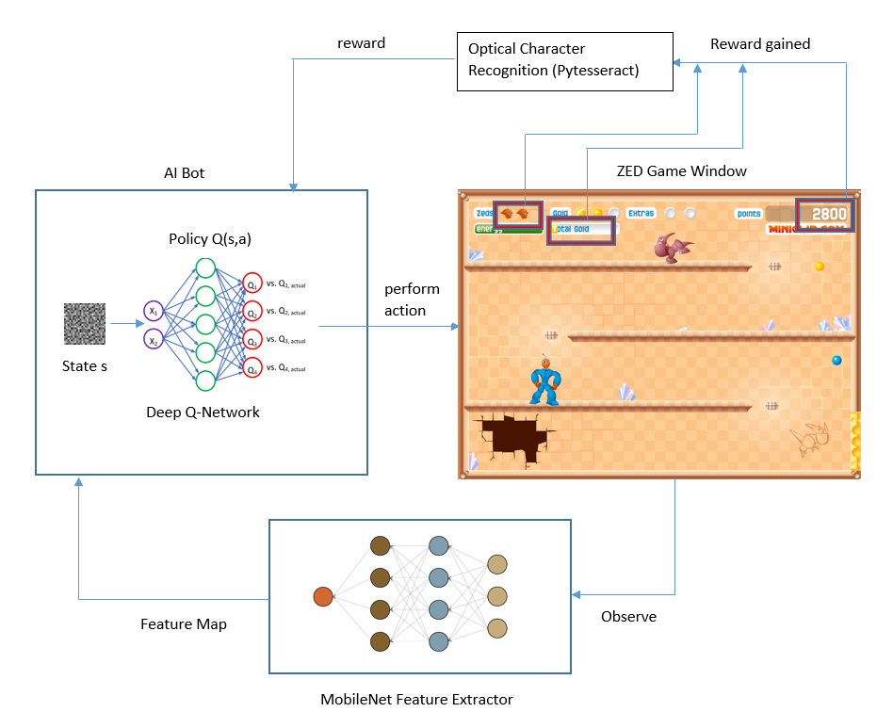
Our Approach
Image-grab for real-time screenshots.
Fed to MobileNet feature extractor.
Feature map passed as current state to Q-Learning model (Dense neural network).
Interacts with environment by taking one of four actions.
OCR parsing on game window to assign reward for the action taken.
Reward passed to the Deep Q-network which adjusts its policy and learns over time.

Slide 6
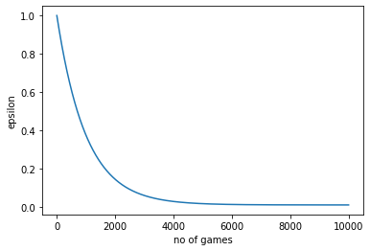
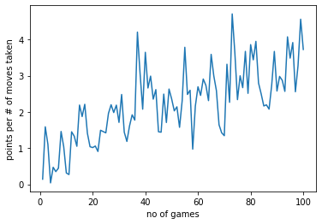
Training stats

Slide 7
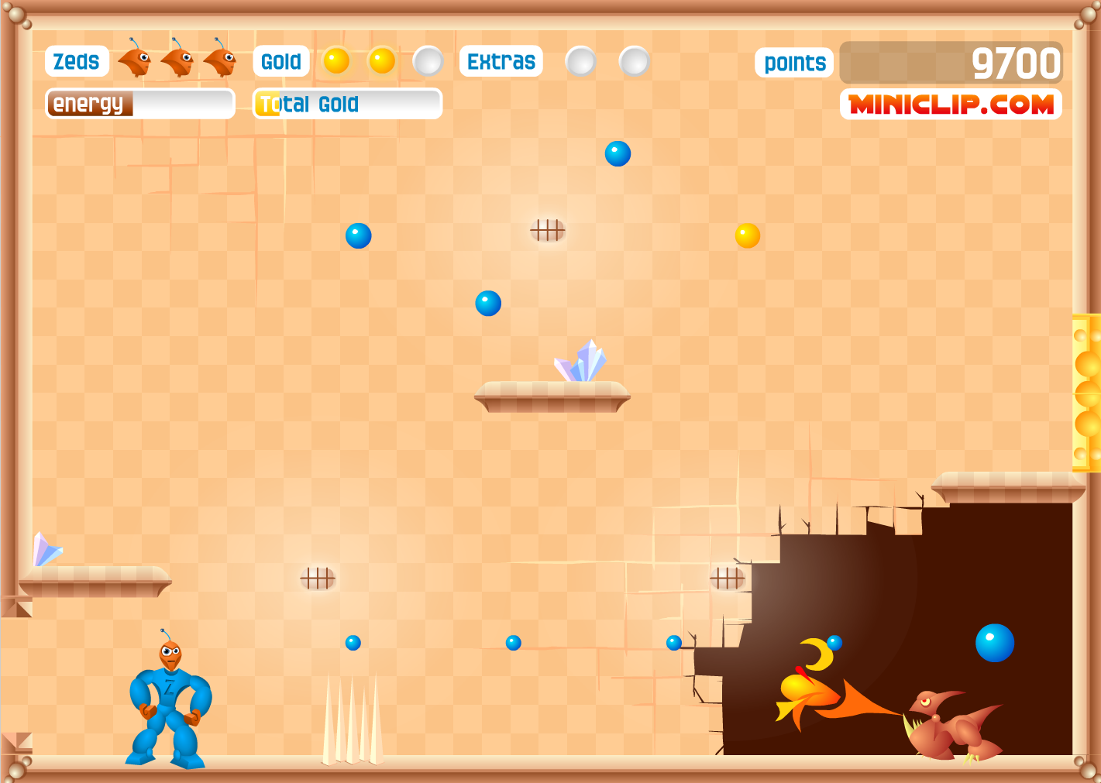
What next?
Improve the reward function.
Train the agent on stage2 of the game (more complex).
Reduce total number of actions from 5 to 4.
Test the trained model.

Slide 8
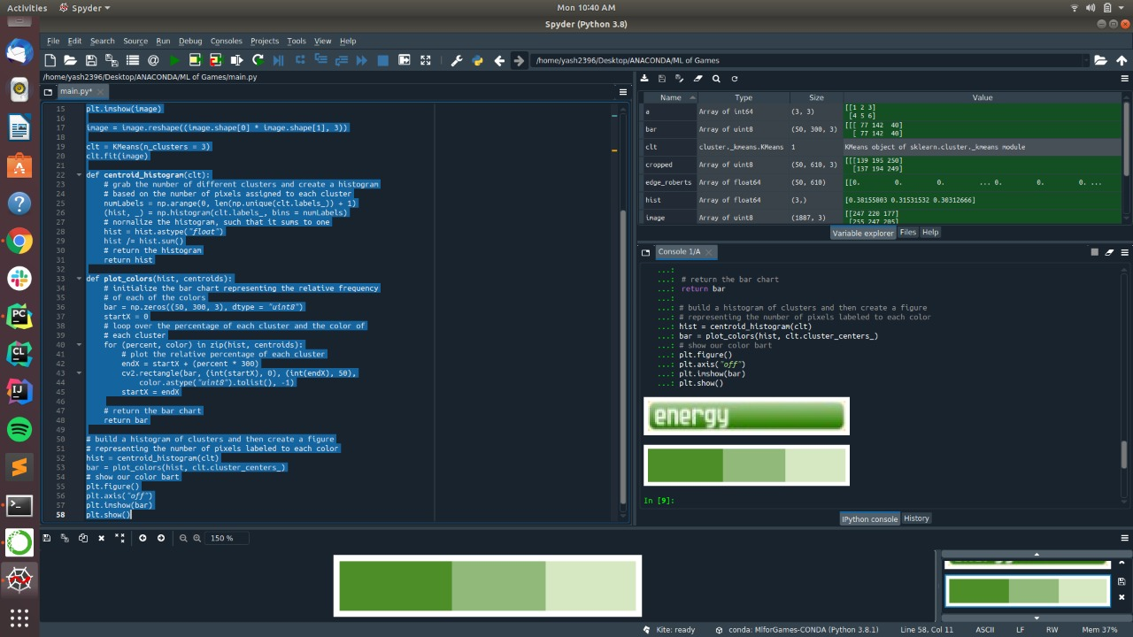
Use color-clustering to gauge the energy bar.
Will be used to optimize/improve the reward function.

Slide 9
References
https://www.google.com/
https://www.youtube.com/
https://www.freecodecamp.org/news/deep-reinforcement-learning-where-to-start-291fb0058c01/
https://github.com/Sentdex/pygta5
https://blog.paperspace.com/dino-run/
https://towardsdatascience.com/how-to-teach-an-ai-to-play-games-deep-reinforcement-learning-28f9b920440a
https://pathmind.com/wiki/deep-reinforcement-learning

Slide 10
THANK YOU!

